Slide 1
Talent Management And Talent Hunting

Slide 2
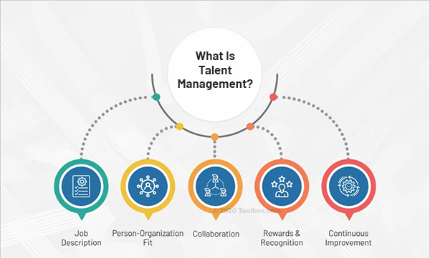
What is Talent Management?
Talent management is defined as the methodically organized, strategic process of getting the right talent onboard and helping them grow to their optimal capabilities keeping organizational objectives in mind.

Slide 3
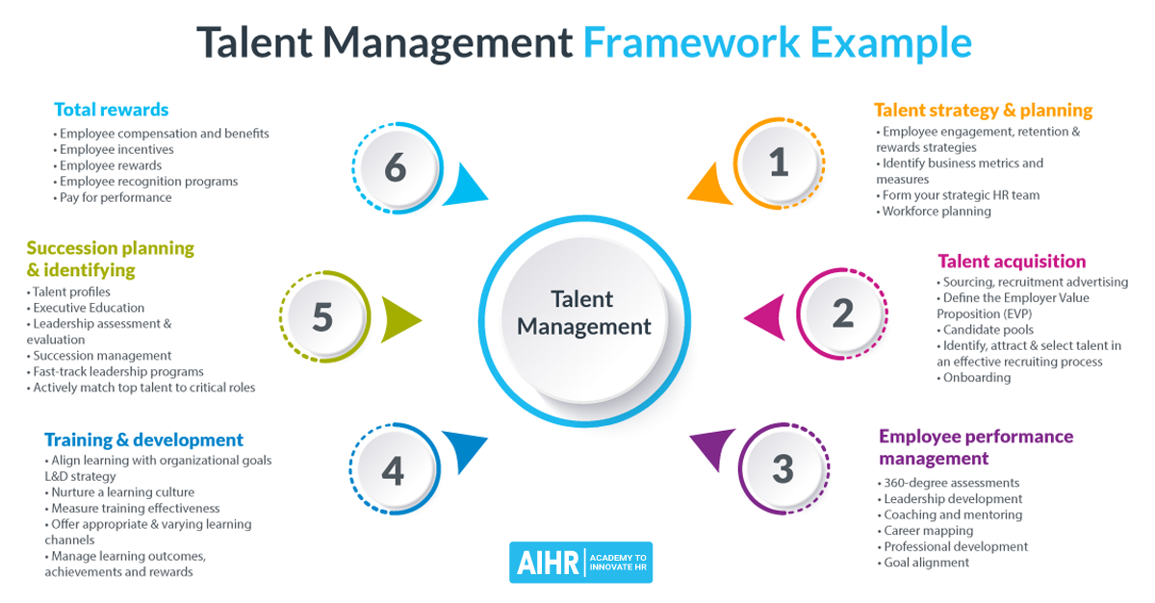

Slide 4
Talent Management Strategy
1. Detailed job descriptions
A well-informed, detailed job description helps the sourcer, the sourcing software, and the candidate understand the job-role better. Generic job descriptions only serve to confuse all parties involved in the talent acquisition process and lead to a wave of irrelevant applications.
2. Person-organization fit
An employee that does not fit into the organizational culture can neither be the happiest employee nor the most sustainably productive one. While the culture can be difficult to define in words, it is prevalent in actions and quite easy to understand whether a candidate would be a good fit or not.

Slide 5
3. Collaborate-coach-evolve
An important strategy to make talent management more effective involves creating a culture of coaching, mentoring and collaboration. Constructive feedback goes a long way when it comes to helping employees evolve and develop their skills and expertise.
4. Reward and recognize right
The process of rewards and recognition forms an important part of the strategy to motivate, engage and manage employees better. This goes beyond financial rewards and bonus packages
This is a great opportunity for organizations to show their employees how much they care for them as persons and as integral aspects of the organizational machinery.
5. Opportunities for continuous improvement
Managing talent needs to be put in the context of the future that the organization has envisioned for itself. Thus, employees need to be equipped with the right tools to be able to maximize their own potential. For the continuous improvement of the organization, there needs to be the scope and opportunities for the continuous development of its employees.

Slide 6

What Is Talent Hunting?
Talent hunters help a company find certain types of technical or high-level positions. They approach prospective candidates currently working in a similar role using their skills Often, talent hunters search for their ideal candidates and extend job offers so that a candidate can leave their current job position for a new role.

Slide 7
The Process Of Talent Hunting work
1. Understand the requirement for a vacant position
Usually, a company may contact a talent hunter or talent hunting agency when they have a vacant position for an executive role. A company may contact these professionals when they know that a top-level executive leaves the position.
2. Know the skills and qualifications required
A talent hunter understands the skills, experience, and qualifications a company seeks in their ideal candidate. After creating a list of necessary skills and experience, they find the best candidate for the role.
3. Search for passive candidates
Depending on the role they are hiring, a talent hunter creates a list of qualified passive candidates. Passive candidates are professionals who are not seeking a job and might work in a similar position with a competitor. Usually, these professionals approach a passive candidate to gauge interest in the open job.

Slide 8
The Process Of Talent Hunting work
4. Interview and review candidates
After the talent-hunting team gathers a set number of interested professionals, they collaborate with the company's hiring team to review their list. After short-listing appropriate candidates, they interview and evaluate professionals to make a hiring decision.
5. Interview and assess the candidate
When hiring employees for a high-level position, often employers may interview candidates to assess their capabilities. After interviewing all shortlisted candidates, the hiring and talent hunting team discuss the potential candidate for a vacant job role.
6. Provide a job offer
After making a final decision, the company sends the job offer letter to qualified candidates. Before sending the offer letter, these professionals negotiate the contract's terms and discuss the salary information. A job offer provides candidates with the job description and expectations from the employer.

Slide 9

Skills Of A Talent Hunter
Communication
Communication skills help a talent hunter communicate effectively with the job seeker and employer. Using their verbal communication skills, these professionals pass the instruction to employers, respond to questions and summarise employer feedback.
Sales and marketing
Sales skills help a talent hunter persuade a candidate to their company. From pitching a company's details to describing the benefits of joining one, sales and marketing skills help a hiring manager convince promising candidates to join their organization.

Slide 10

Skills Of A Talent Hunter
Relationship building and teamwork
Successful talent hunters develop a positive relationships with employers and candidates. Building relationships helps in enhancing communication and collaborating with qualified candidates. Also, relationship building helps talent hunters understand and find candidates passionate about the job role.
Attention to details
As talent hunters try to fill many positions, you require excellent attention to detail. Employers prefer detail-oriented candidates. Having precise plans and giving attention to more information can help you manage several activities at one time.

